Slide 1
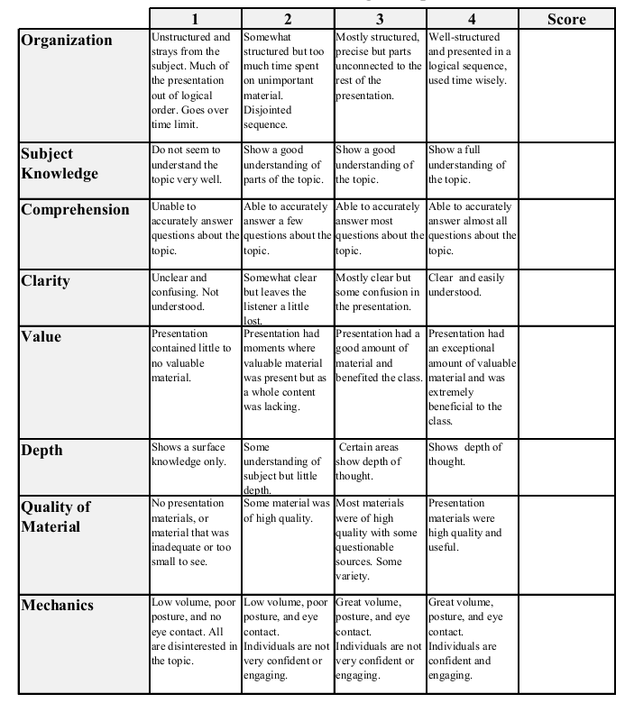
Fall 2014: Econ 339 Final Presentation
Brandyn Lazar
December 4th, 2014
Do more health insurance options lead to higher wages?
Reference: Marcus Dillender (2014), Do more health insurance options lead to higher wages? Evidence
from states extending dependent coverage, Journal of Health Economics, vol.36, nr., p84-97
Total:_________

Slide 2
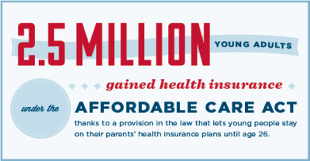
31.1% men, 23.6% women ages 18-26 are Uninsured

Slide 3
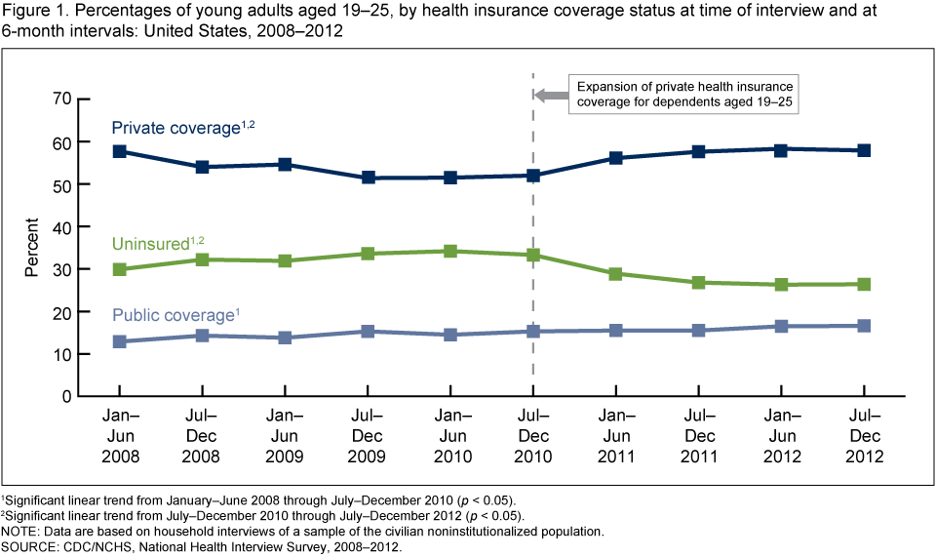

Slide 4
Wage Increases to Dependent Young Adults
Extended dependent coverage allows younger adults to seek out higher paying jobs
More time to search for those jobs
Allows time to further their education
(Staying on dependent plan reduces opportunity cost of going to college)
Earning higher wages
Individuals using dependent insurance plan may not see wage increase until after eligibility

Slide 5
Extending Health Insurance Effect Education
15% of men ages between 22-26 were still in college
Extending dependent coverage to 26 would increase coverage in these age groups by 9%
Additional year of college increases wages from a range of 9-14%
(For men, at upper end of age distribution its higher)

Slide 6
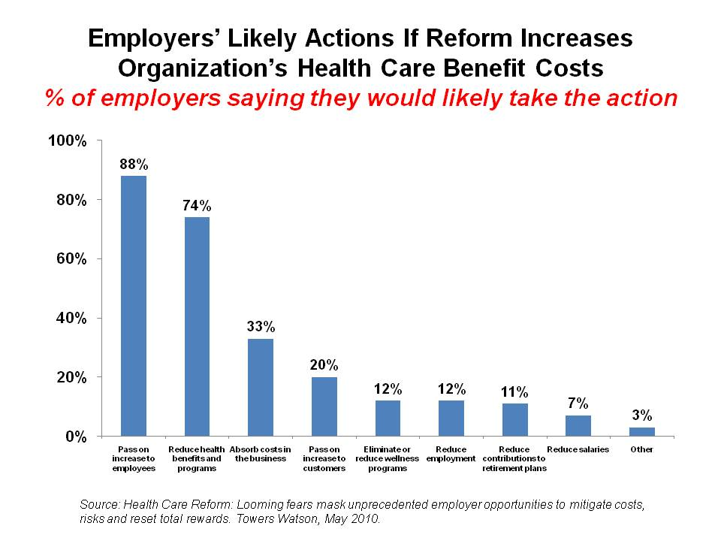

Slide 7
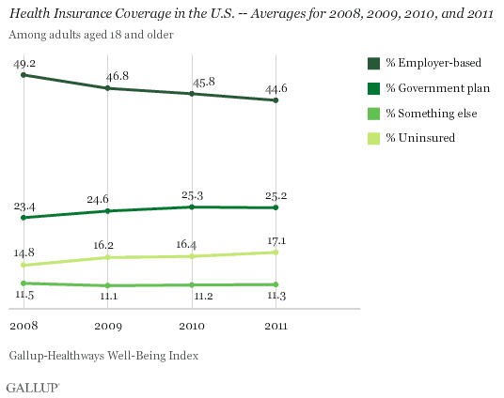
Employer Based Plans

Slide 8
Conclusion
For the young, having an outside source of employer-sponsored insurance leads to an increase in wages
Men 18 and younger with dependent coverage, wages increase by 1.6% after they aren’t eligible for coverage through their parents employer (Women are 2.1% at the time of reform)
Extending dependent coverage from 22 to 26 lowers cost of being in school at later ages
Opportunity cost of being in schools falls; being in school no longer means losing access to cheap health insurance
Affordable Care Act leads to increasing wage increases for young adults by an average of 3.5-4.6%

